Slide 1

NYU Cyber Fellows
CS GY 6573
Penetration Testing
Scanning Lab
©2021 NYU Tandon School of Engineering

Slide 2
Limitation of Liability
During this lab, we will be scanning targets we don’t own but we do have authorization to scan
Making a mistake can cause untended harm or damage
Depending on your Kali configuration, you can scan the VM provided or scan a live target we have authorization
By participating in this lab and scanning outside targets, you are agreeing that you are scanning at your own risk
You will only scan authorized targets
NYU will not be liable for any damage you cause do to negligence or mistakes

Slide 3
Lab Format
In the last lab, all commands were provided
Moving forward, you will be challenged to figure out the commands or the method of execution yourself
Answers will always be provided on a following slide or in a separate answer slide deck
Use the answer if you need to, but try to figure it out yourself
Learning and reading man pages is the backbone of becoming a master

Slide 4

TCPDump

Slide 5
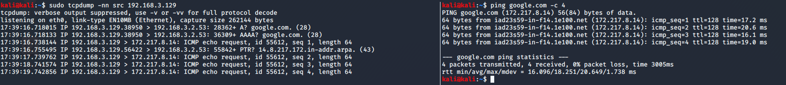
Tcpdump on graphical Kali
For most of our scans, watch them with tcpdump
GUI Kali
Open up two console windows
One for scanning, one for tcpdump
$sudo tcpdump –nn
-nn will not resolve domain or port numbers
If you’re on a noisy network, a filter would help keep things easy to understand
$sudo tcpdump –nn src [kali’s IP] or dst [kali’s IP]
Test it with a ping to a network IP or address

Slide 6
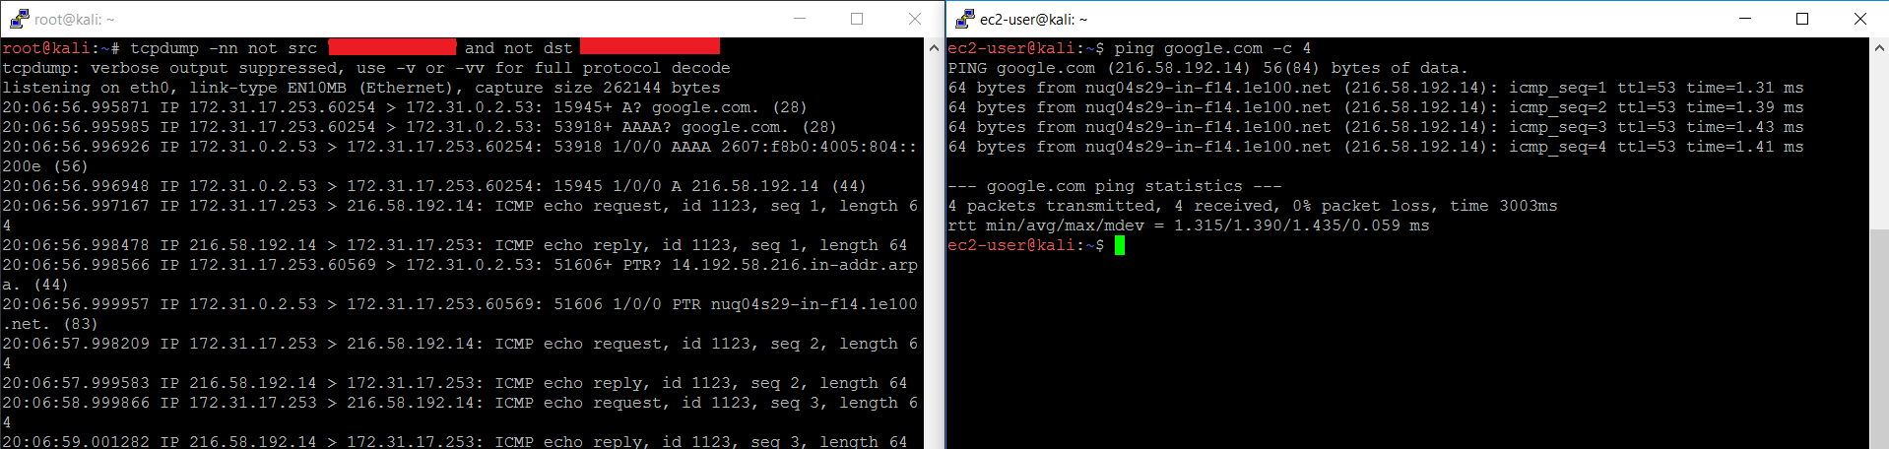
Tcpdump on Kali over SSH
For EC2 Kali, we can accomplish the same with multiple SSH windows
Since we’re connecting over SSH, we need to filter out our SSH traffic
$ sudo su –
# tcpdump –nn not src [your IP] not dst [your IP]
Remember to use your external IP, not your internal IP
https://www.google.com/search?q=whats+my+ip

Slide 7
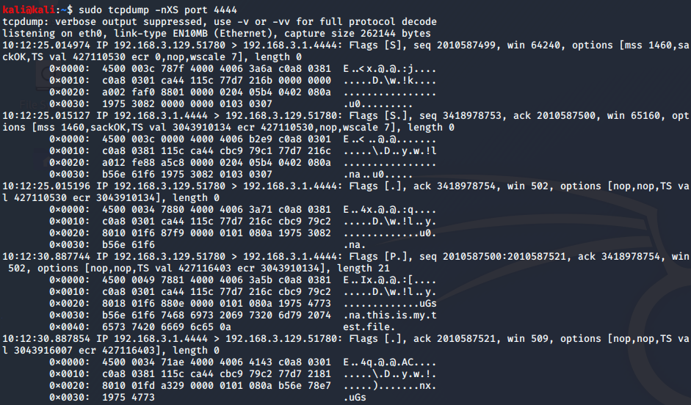
TCPDump Full Output
We can see packet payload when it is plain text
$sudo tcpdump -nXS

Slide 8
netcat

Slide 9
netcat
Using ncat, perform these simple tasks demonstrated in the lecture
Start a listener on your Kali machine. Use your local machine to connect to it using a browser to see your browser information
Transfer a small file using netcat from your host machine to your Kali VM twice
Try both pushing the file and pulling the file
Create a listener first on Kali which dumps the output to a file
Create a listener first on your local machine to send a file when there is a connection
If using EC2 and your host is behind a firewall or NAT, this may not work
Using specifically ncat, create an encrypted tunnel between your host machine and Kali. Did it work?

Slide 10
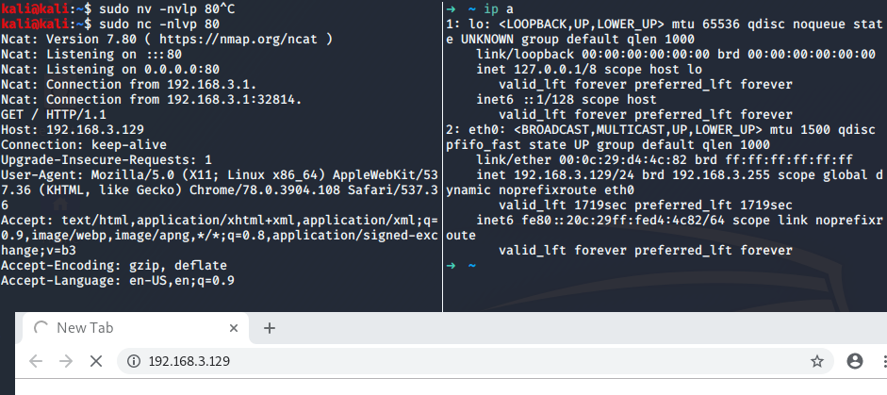
1. simple connection
$sudo nc -nlvp 80
-n: no name resolution
-l: listen
-v: verbose
-p: port
need sudo because we will be listening on reserved ports(0-1023)
Browser will keep waiting for response, because we didn’t let nc respond to requests.

Slide 11
2. Pushing a file
On your host system (showing Windows syntax)
C:\> ncat -nlvp 80 > [file]
On Kali
$nc -nv [host IP] 80 < [file]

Slide 12
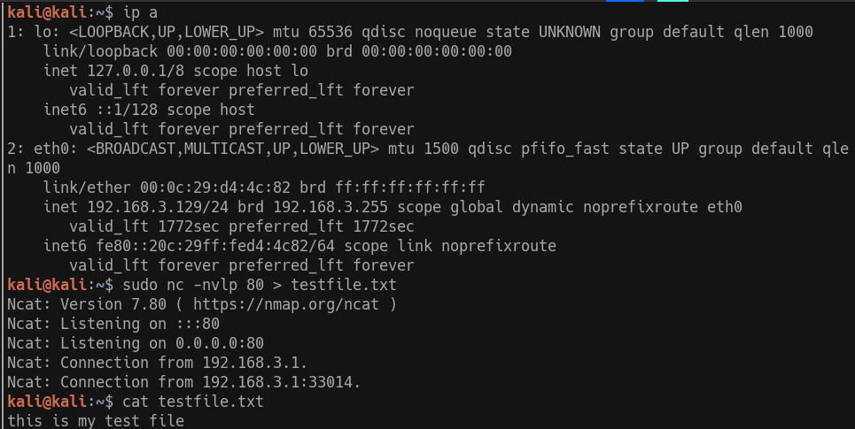
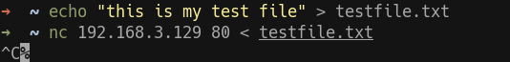
2. Pulling a file
On Kali
$sudo nc -nlvp 80 < [file]
On your host system (showing Linux syntax)
nc [kali ip] 80 > [file]

Slide 13
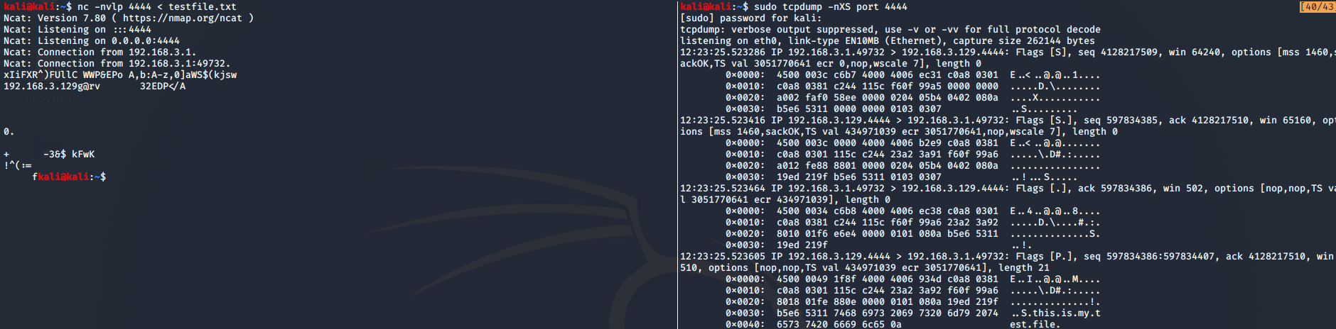
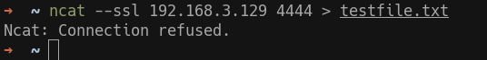
3. Encrypted Tunnel
Failed, if only one side uses --ssl or does not have ncat only netcat
We even see the payload was sent in plain text!
Netcat tries to show the output of encrypted SSL traffic

Slide 14
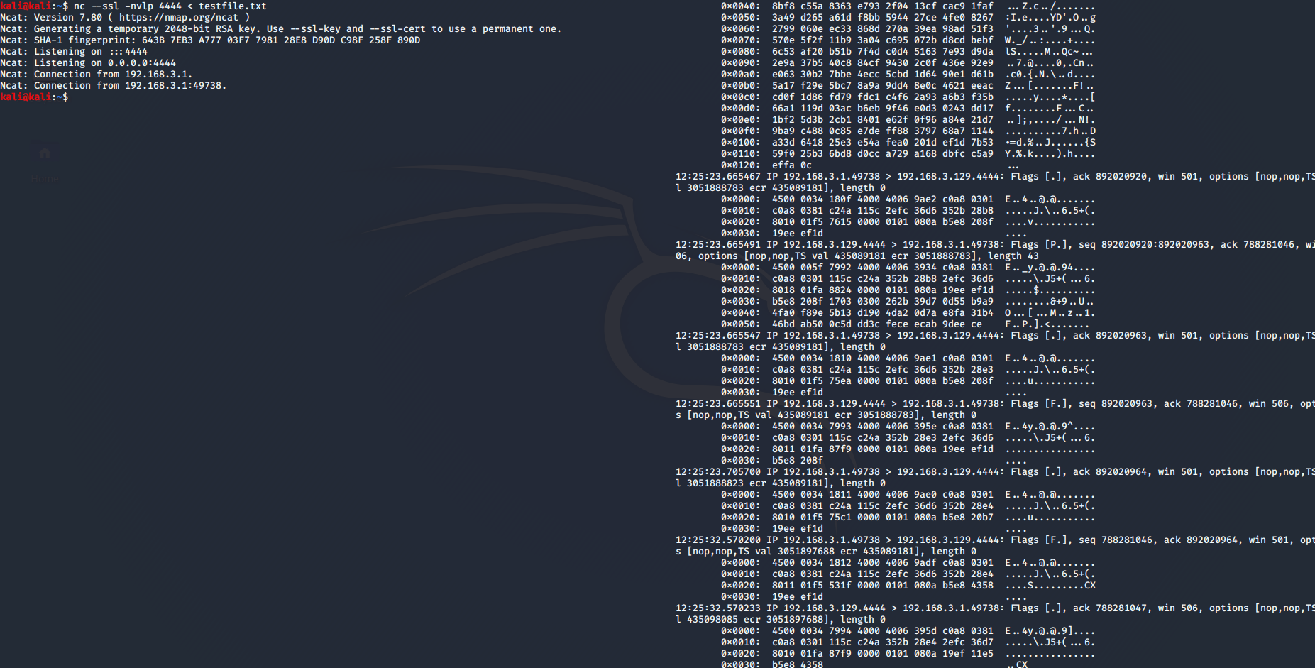
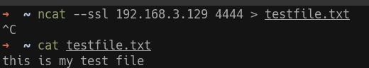
Encrypted Tunnel
Success!
tcpdump also shows encrypted traffic, compare to the last slide

Slide 15
Traceroute

Slide 16
Traceroute
For this scan, we need a more verbose output from tcpdump
$ sudo tcpdump –nn –vv
This will show us the TTLs
Run a traceroute to google.com, using only one probe per ttl
Do you see the TTL incrementing?
Don’t forget to start tcpdump and watch the scan

Slide 17
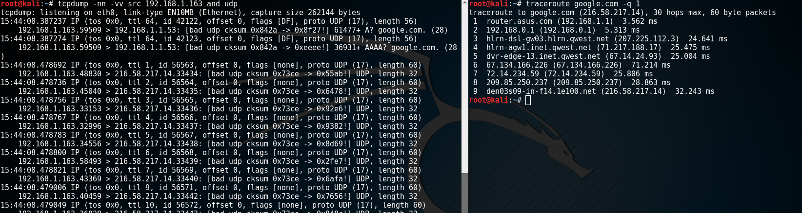
Traceroute
$ sudo traceroute google.com -q1
-q 1 will only send one packet, default is 3
Note the ttl incrementing
You may not be able to see intermediate hops according to your network(it shows “*” instead)

Slide 18
Scanning Target, warnings, and tips

Slide 19
Scanning target
For this section of the lab, you will need to adjust your VM settings to internal network
If using a cloud-based version of Kali, you may perform scans against a target we have authorization to scan
You may also target this for extra practice
scanme.nmap.org (45.33.32.156)
This lab will focus on the virtual machine, scanning the live target is optional

Slide 20
Optional Scanning: Live Target scanme.nmap.org
If you are scanning the live target:
Do not perform any kind of intrusive scanning against this target
Make sure you only target this server
Do pay attention to detail and avoid typos
You may experiment on your own lab or internal network if you own it
You may NOT scan the network if you are on a shared or public network
We must have explicit authorization to scan
https://nmap.org/book/legal-issues.html
Hello, and welcome to Scanme.Nmap.Org, a service provided by the Nmap Security Scanner Project and Insecure.Org.
We set up this machine to help folks learn about Nmap and also to test and make sure that their Nmap installation (or Internet connection) is working properly. You are authorized to scan this machine with Nmap or other port scanners. Try not to hammer on the server too hard. A few scans in a day is fine, but dont scan 100 times a day or use this site to test your ssh brute-force password cracking tool.
Thanks -Fyodor

Slide 21
Metasploitable

Slide 22
Metasploitable
Metasploitable 2 is an Ubuntu distribution released by Rapid7
Its purpose is to be vulnerable and let us practice!
Direct Download:
http://downloads.metasploit.com/data/metasploitable/metasploitable-linux-2.0.0.zip
Or sourceforge mirrors:
https://sourceforge.net/projects/metasploitable/
Metasploitable has been around since 2012 and is well documented
Troubleshooting should be easy. If any issues completing anything in this lab, research first, then ask questions

Slide 23

Network Setup - VirtualBox
Part of this lab will require that we use VirtualBox since there is no version of Metasploitable ready and available AWS
AWS only allows penetration testing of medium systems (you need to pay $$$) and also get explicit authorization
It should NEVER be allowed to face the open internet
This system's purpose is to get scanned and hacked
Exposing to the internet will probably turn it into a bitcoin mining host within a day
Security - We will use host-only networking
This will allow our VMs and host to communicate internally
This will disconnect our VMs from the internet
Alternatively, we can whitelist IP addresses using iptables

Slide 24
Deploying the VM

Slide 25



Setup
You are to deploy the image to your local machine
You will need to configure VirtualBox, VMware, etc.
Your host-only interface needs to be setup so you are on the same network
Do not expose this VM to the internet or an untrusted network - it's vulnerable
The next few slides we will:
Deploy VM
Set up host-only networking
Configure Kali and the VM
Metasploitable2
You
10.10.0.*
10.10.0.20
10.10.0.0/24

Slide 26
Network
How you set up networking is up to you but remember that this VM is very insecure!
If you are in your own private network behind a NAT gateway (like a router), it may be safe to just set it up on your own local network in bridged mode
It doesn't matter how you set it up, just as long as the VMs can communicate on the same subnet
The following slides will walk through how to set it up in the most secure state: Host-Only

Slide 27
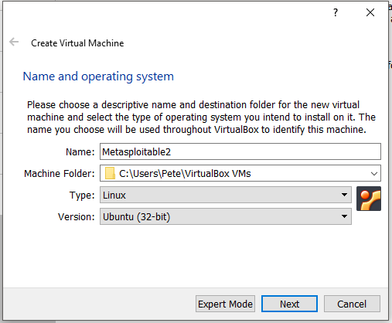
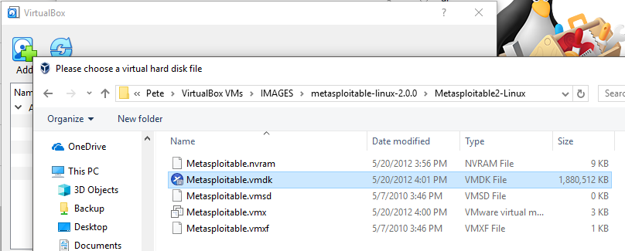
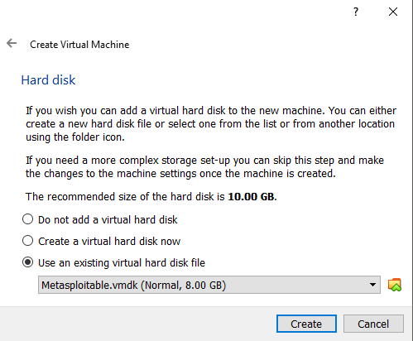
Metasploitable
Download and Unzip metasploitable-linux-2.0.0.zip
Instructions for deploying in Virtualbox:
Open VirtualBox
Machine->New... (Ctrl+N)
Name: Metasploitable
Type: Linux
Version: Ubuntu 32-bit
Default RAM
Use existing virtual hard disk -> Metasploitable.vmdk
You will need to manually add it
Start VM
Username and password are both 'msfconsole'
Stuck with keyboard-only input on a small screen
You can SSH into it on a GUI for a more friendly interface if required

Slide 28
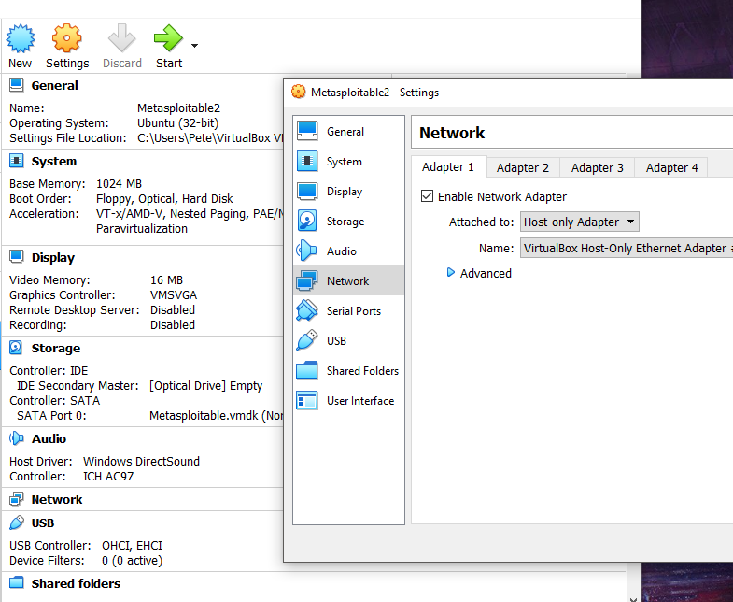
Networking
We will use host-only networking
This way, no accidents :)
Go to Settings
Network
Select Host-only Adapter
You will need to do the same for your Kali VM

Slide 29
Networking
Start the Metasploitable VM and Kali
Once they are both on, you will need to set IPs on the same subnet so they can communicate
You can use a different network address for your host-only network
All the examples in this lab will assuming you are using 10.10.0.0/24
Next: Setup your IP addresses

Slide 30
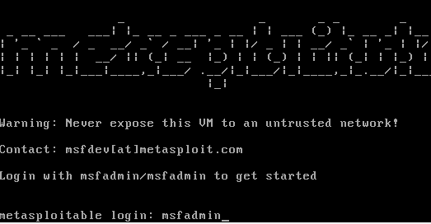
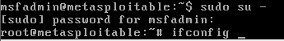
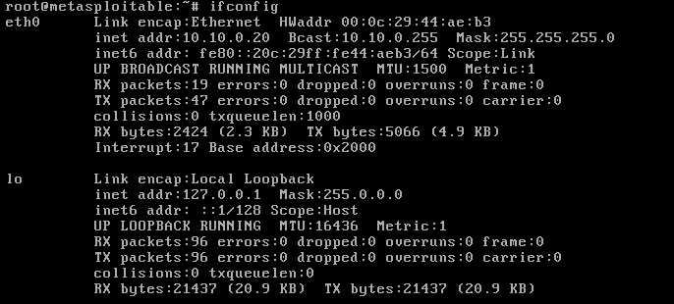
Metasploitable Setup
Login, escalate privs, and set IP
Login with 'msfadmin' as user and pass
Become root
$ sudo su -
Enter password again: msfadmin
Check name of network adapter
Probably 'eth0' but could vary
# ifconfig
Set your IP where [name] is your adapter, probably eth0!
# ifconfig [name] 10.10.0.20 netmask 255.255.255.0

Slide 31
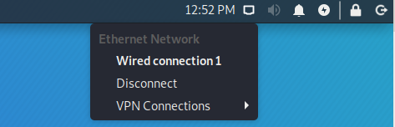
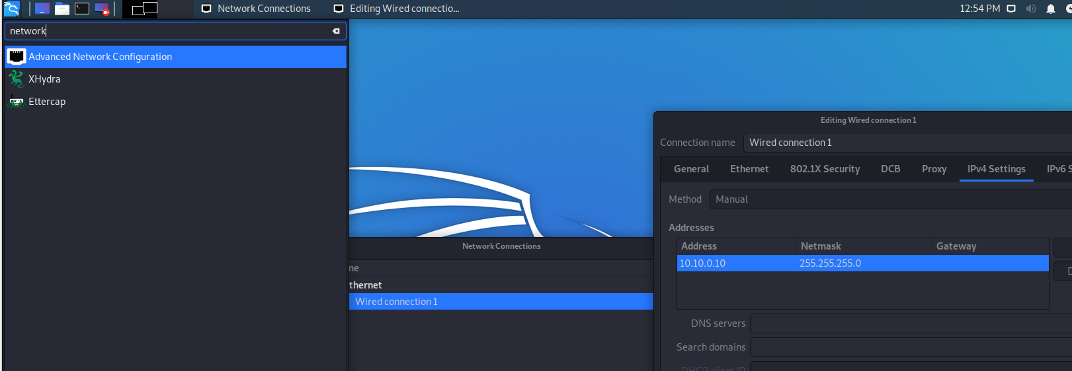
Kali Setup
On Kali
Using GUI, manually set your IP address
Try to ping Metasploitable from Kali to make they are connected
Troubleshooting? Try turning the network adapter off and back on again

Slide 32
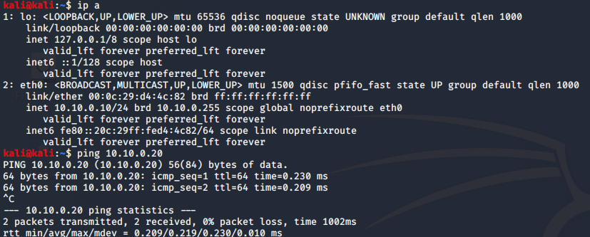
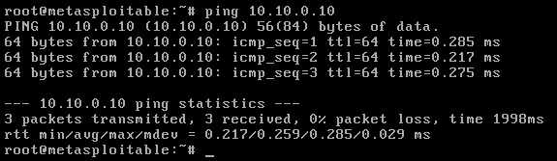
Ping to check
Ping both ways...success!

Slide 33
nmap

Slide 34
General Tips
Although we covered it in class, keep your scans to the bare minimum!
Do not do a complete port scan if you only need to find hosts
Use the -sn or -sP options to only test for hosts, do not port scan
Do not test for hosts that you know are already up
Use the -Pn to skip testing for host connectivity
Only target what you need, if applicable
If you’re looking for a common webserver, first try -p 80,443,8080 only
Don’t scan 65,535 ports, or even the top 1000
If you’re scanning multiple hosts, look at what you’re scanning first
Use the -sL to not scan but only list your targets
If you’re on a 255.255.255.0 netblock, don’t scan the CIDR/16
255 hosts is much more polite than looking for 65,535 hosts
If you make a mistake, CTRL+C to kill the process
Some scans require root privilege, or you may get different results.

Slide 35
Nmap - Network Impact
Depending on what kind of scan we are doing, nmap and other scanning tools can cause a lot of network traffic
We can measure this impact by using iptables
For some of the scans in the rest of this lab, use iptables to measure the total traffic volume created by our scans
Iptables - IP4/6 firewall, filter, and NAT built into Kali
$ sudo iptables -I INPUT 1 -s 10.10.0.20 -j ACCEPT
$ sudo iptables -I OUTPUT 1 -d 10.10.0.20 -j ACCEPT
$ sudo iptables -Z
To view and reset the traffic usage
$ sudo iptables -vn -L -Z

Slide 36
Iptables - About the command
$ sudo iptables -I INPUT 1 -s 10.10.0.20 -j ACCEPT
$ sudo iptables -I OUTPUT 1 -d 10.10.0.20 -j ACCEPT
$ sudo iptables -vn -L -Z
-I: Inserting a new rule
INPUT/OUTPUT: Incoming traffic or outgoing traffic
1: make this the first rule if there happen to be many rules
If there are things to drop packets, protections in place, they will not be affected by this rule. This is only a counter and we want to count traffic first
-s 10.10.0.20: Source IP, traffic from the target
-d 10.10.0.20: Destination IP, traffic to the target
-j ACCEPT: Specify what to do with any packets that match the rule. We can chain packets to other rules, accept, reject (rst return) or drop (silent) them. In this case, we will accept them.

Slide 37
Iptables - About the command
$ sudo iptables -I INPUT 1 -s 10.10.0.20 -j ACCEPT
$ sudo iptables -I OUTPUT 1 -d 10.10.0.20 -j ACCEPT
$ sudo iptables -vn -L -Z
-Z: zeroize the counter
-L: list the counter
-n: no name resolution
-v: verbose, to see counters
-L: List the rules and chains

Slide 38
Scanning target
Warm up:
Perform the following nmap scans on our target, 10.10.0.20
You can use tcpdump to verify what the scans are doing
You can also use --packet-trace
If you're scanning any local VM, try increasing the timing to 4!
This should speed things up. T5 may cause false results and dropped packets
Make sure to use your Iptables and check it out after

Slide 39
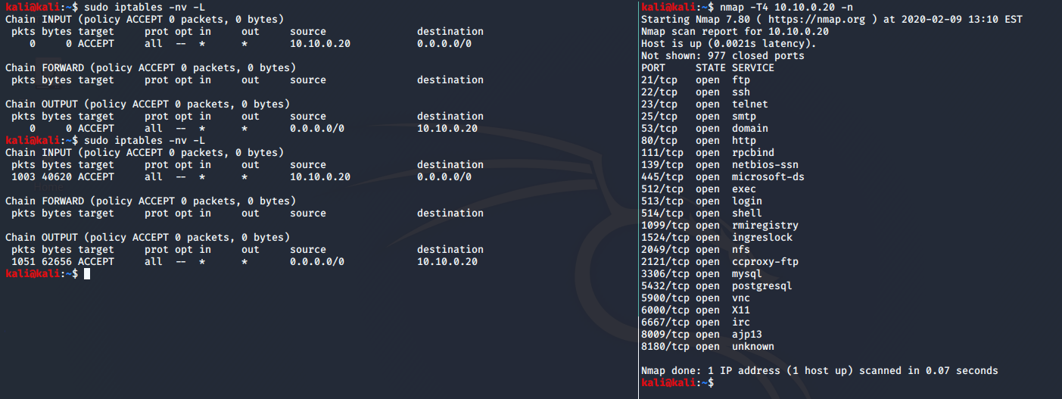
Warm up
We see that the scan of the top 1000 ports used about 103kB of bandwidth

Slide 40
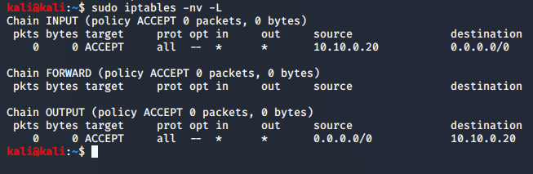
Iptables Zeroize
Don't forget to zeroize your iptables rules
Continue to use iptables to see what kind of impact you have on a network
Keep this in mind when thinking about what time or what kind of scan to run
Especially if you are scanning larger than a /24 network, all ports!

Slide 41
Nmap lab questions
Scan the target for connectivity only, no ports. Let’s make sure we can access it
Scan the target, scan all ports, TCP connect scan
What ports are open?
Scan the top 20 ports with UDP only, and have nmap show you the reason
Did you see any new ports open?
Two scans: scan the top 20 ports, have nmap show you the reason, make the timings Insane (5) and then Polite (2)
Anything different?
Scan all open ports only, Normal timing, TCP connect, enable version scanning, include reason, and output to an xml file

Slide 42
nmap answers
on the next page

Slide 43
Nmap answers
Scan the target for connectivity only, no ports. Let’s make sure we can access it
$ nmap 10.10.0.20 -sn -T4
The target should be up
By default, we see that nmap sends an ARP request for local targets when executed as privileged user
External targets (or if we use --disable-arp-ping), we see 4 packet scan

Slide 44
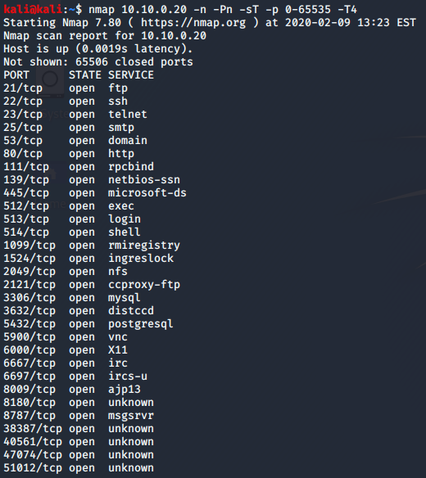
Nmap answers
2. Scan the target, scan all ports, TCP connect scan
What ports are open?
$ nmap 10.10.0.20 -sT -p 0-65535 -T4
Or
$ nmap 10.10.0.20 -sT -p- -T4
Open ports

Slide 45
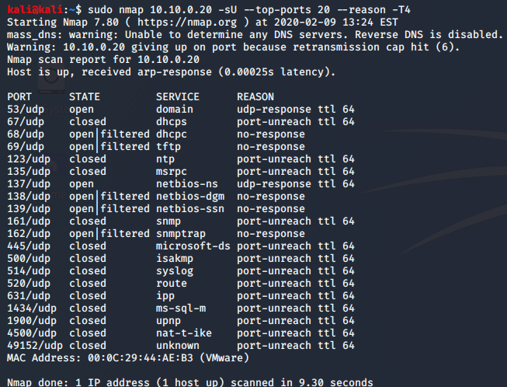
Nmap answers
3. Scan the top 20 ports with UDP only, and have nmap show you the reason
$ sudo nmap 10.10.0.20 -sU --top-ports 20 --reason -T4
Which ports are new?

Slide 46
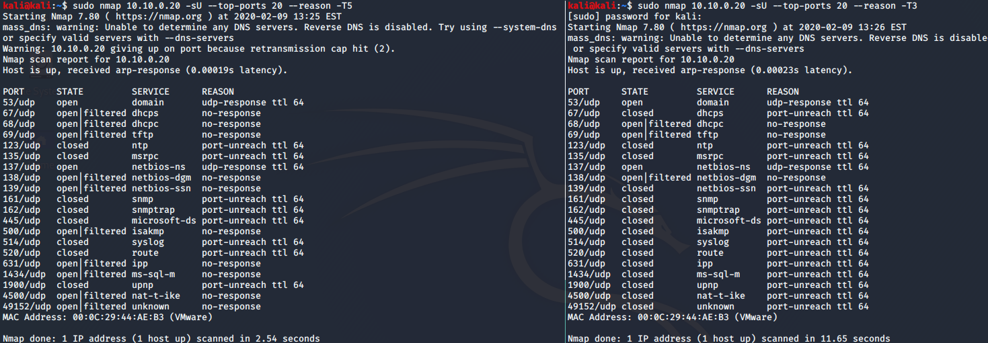
Nmap answers
4. Two scans: scan the top 20 ports, have nmap show you the reason, make the timings Insane and then Polite
Anything different?
$ sudo nmap 10.10.0.20 -sU --top-ports 20 --reason -T5
$ sudo nmap 10.10.0.20 -sU --top-ports 20 --reason -T3
Network congestion, not waiting long enough or flooding can give us false results

Slide 47
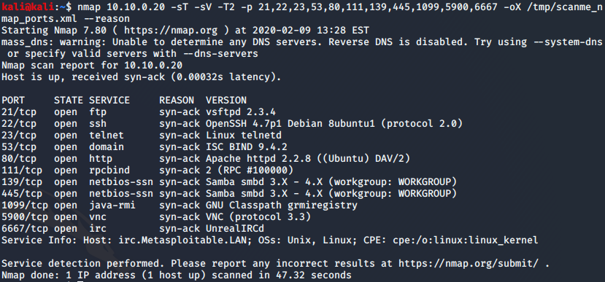
Nmap answers
5. Scan all open ports only, Normal timing, TCP connect, enable version scanning, include reason, and output to an xml file
$ nmap 10.10.0.20 -sT -sV -T2 -p [ports] -oX /tmp/scanme_nmap_ports.xml --reason

Slide 48
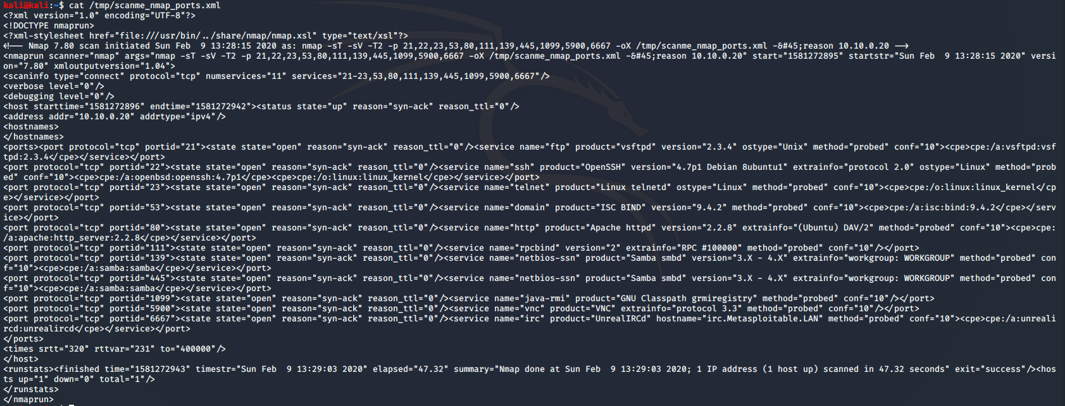
Nmap answers
Take a look at the xml file you created
$ cat [xml file]
Written well in format we can use later in applications or scripts
Greppable format (-oG) is very useful against multiple hosts

Slide 49
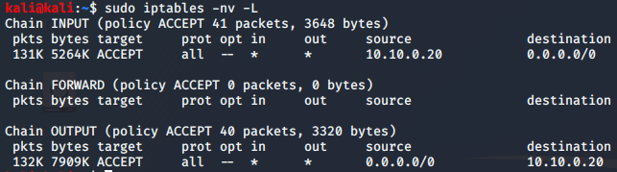
Traffic Impact
Look at iptables again
Did you zeroize in between scans?
Even a couple single-host scans generated MBs of traffic

Slide 50
Nmap badsum
Open up your tcpdump in another window
Scan the top 100 ports, SYN stealth scan (default), and don’t check host to see if it’s up
Repeat the same scan but use bad checksums this time
What differences did you notice?

Slide 51
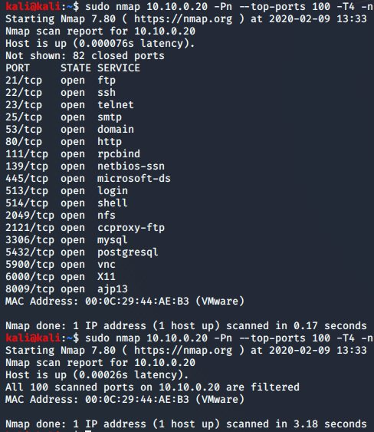
Nmap badsum
Scan the top 100 ports, SYN stealth scan (default), and don’t check host to see if it’s up
$ sudo nmap 10.10.0.20 -Pn --top-ports 100
Repeat same but use bad checksums this time
$ sudo nmap 10.10.0.20 -Pn --top-ports 100 –badsum
What's different?
Badsum causes the target to behave in different ways
Maybe our packets get dropped by the host and we get no response
If they hit a firewall though, we might see a response
Using Badsum or ACK scans help us identify firewalls. Pay attention to the TTL!

Slide 52
Scapy

Slide 53
Scapy + tcpdump questions
Again, let’s enable tcpdump so we can watch our output
Use a filter so we only see packets going between our IP and the target
Enable hex and ascii output
Don’t resolve any names or ports
Same target, 10.10.0.20
Using scapy, send and receive some packets to the target
TCP to ports 79-80. Are the ports open or closed, and why?
ICMP echo request with a payload “test123”
Same as ‘nmap 10.10.0.20 -p 31330-31340,22 -sX’
Hint: use ls([protocol]) to learn more about it, ex. >>> ls(TCP) use lsc() to see all supported functions

Slide 54
Scapy possible solutions
TCPdump:
We want to see only between us and the target
host [ourIP] and host 10.10.0.20
Enable hex and ascii, and don’t resolve names
-nnX
$ sudo tcpdump -nnX host [ourIP] and host 10.10.0.20

Slide 55
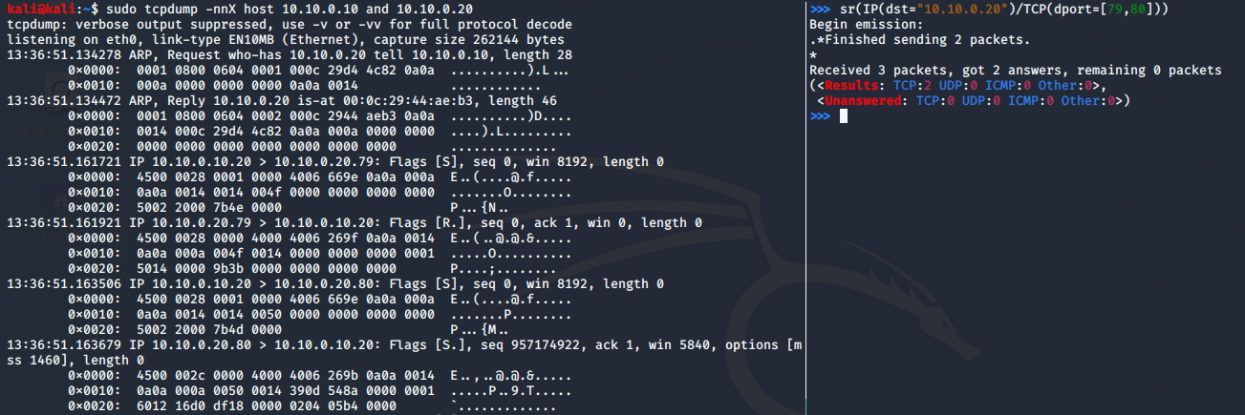
Scapy possible solutions
Scapy, send and receive packets to TCP to ports 79-80
$ sudo scapy
>>> sr(IP(dst="10.10.0.20")/TCP(dport=[79,80]))
Port 79 is closed, port 80 is open
79 sent back a RST ACK
80 sent back a SYN ACK

Slide 56
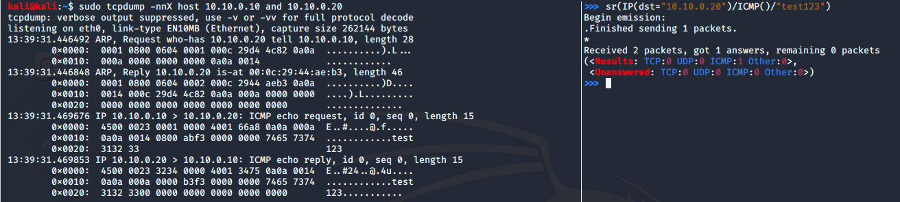
Scapy solutions
ICMP echo request with a payload “test123”
>>> sr(IP(dst="10.10.0.20")/ICMP()/"test123")
And it echoed back!

Slide 57
Scapy solutions
Same as ‘nmap 10.10.0.20 -p 31330-31340,22 -sX’
This is just one way to solve this
Remember our TCP flags
Xmas packet is FIN PSH and URG
TCP flags are URG ACK PSH RST SYN FIN (32,16,8,4,2,1)
32+8+1=41
Create a list for our TCP dport
>>> dports = []
>>> dports.append(22)
>>> for x in xrange(31330,31341):
... dports.append(x)
Send it
>>> for x in dports:
... sr(IP(dst="10.10.0.20")/TCP(dport=x,flags=41))

Slide 58
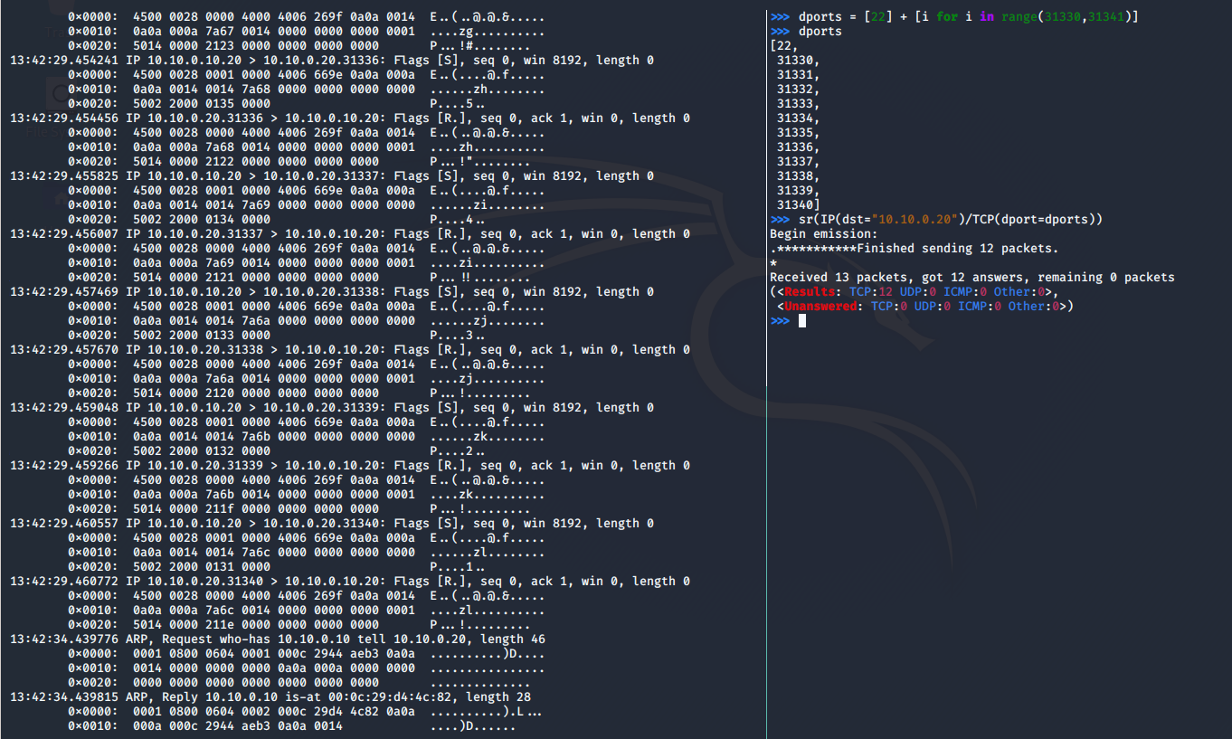
Scapy solutions

Slide 59

EyeWitness
Spider and Scanner for Websites

Slide 60
From Recon to Scanning
In this section, we will use a tool from last week to get us a list of targets
Then we will scan the targets
Recon and enumeration is important but can lead to many dead ends or false positives
Like finding a needle in a haystack
While there is no substitute for manual analysis, some tools or combinations of tools make the analysis quicker and easier

Slide 61
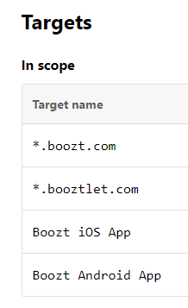
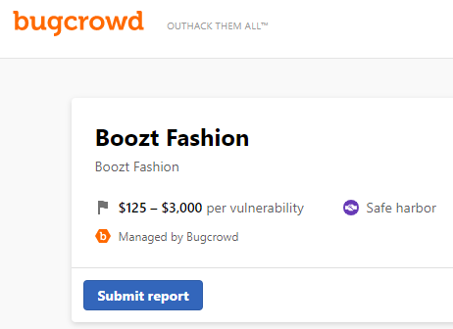
Target - Boozt
Boozt
“Boozt.com is an online shop with clothes, shoes and accessories for the entire family. Our store opened in 2009 and offers the best shopping experience with daily new arrivals, a wide selection, and last but not least good offers.”
They are authorizing security researchers to look for bugs, with a strict scope and limitation
Read this - https://bugcrowd.com/boozt-og

Slide 62
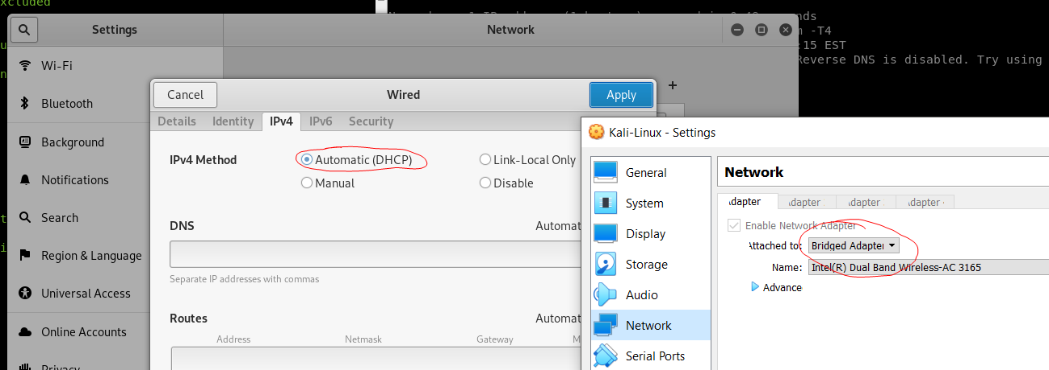
Kali - Back to Bridged or NAT
For this part of the lab, we will need Kali to be able to reach the internet
Switch your networking back to Bridged or NAT
You can close Metasploitable at this time too

Slide 63
EyeWitness
EyeWitness
Created in 2014 by Chris Truncer
https://www.christophertruncer.com/eyewitness-usage-guide/
Automatically scans a provided list of URLs, grabs screenshots of webservers, VNC servers, and anything else interesting
Getting more into scanning than OSINT and Recon
Installation
# cd /opt
# git clone https://github.com/FortyNorthSecurity/EyeWitness.git
# /opt/EyeWitness/setup/setup.sh

Slide 64
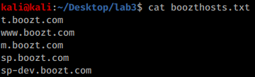
We will do a light scan of Boozt's site to test out EyeWitness
Use recon-ng or Amass to get at least 15 subdomains from the *.boozt.com domain
Build into a list of domains and subdomains, separated by linebreaks
Do not use active or brute force methods
If you get more than 50, stop!

Slide 65
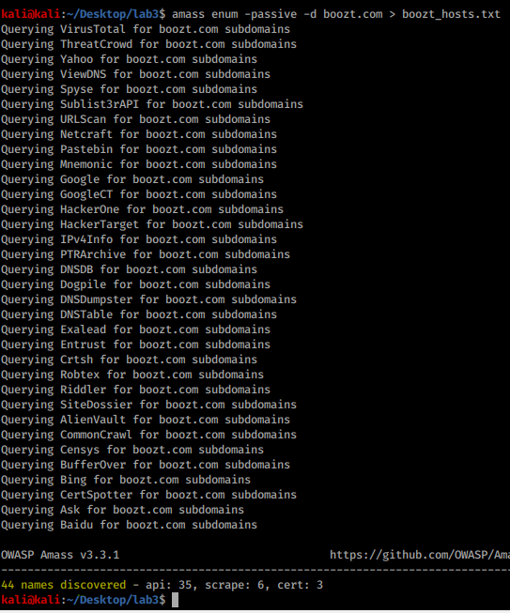
SPOILER
Amass example
$ amass enum -passive -d boozt.com > boozt_hosts.txt
Depending on the options you use, you can get more domains than necessary for the lab
No need for more than 50
# cat eff.txt | head -n 100 > eff_urls.txt

Slide 66
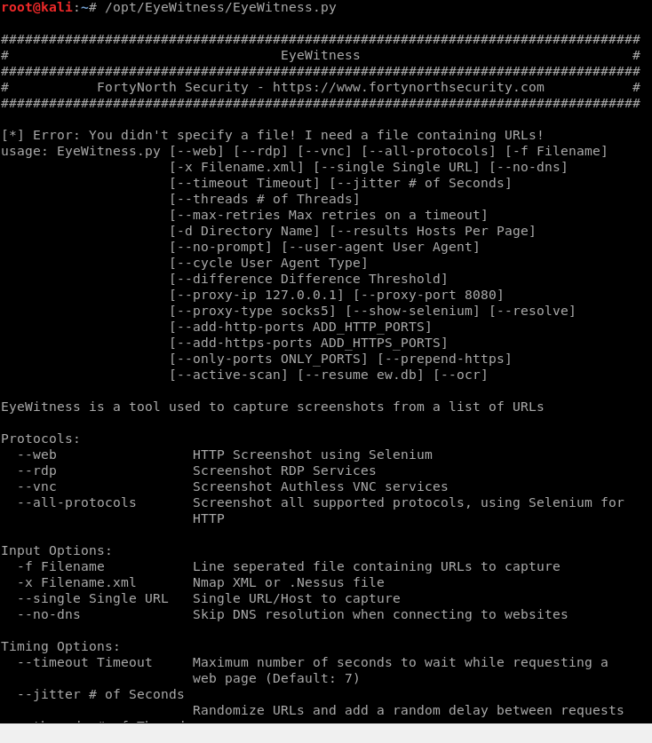
EyeWitness Usage
EyeWitness can be used to scan websites, RDP, or VNC services
Anything graphical
Basic usage
Specify what you are targeting
--web
--rdp
--vnc
--all-protocols
Provide an input file of URLs or IPs
-f [Filename]
There are more options to set ports
Default ports are only used normally

Slide 67
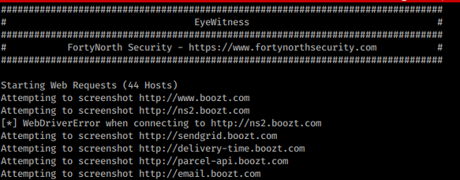
Scan EFF for websites
Run the scan
# /opt/EyeWitness/EyeWitness.py --web -f boozt_hosts.txt
Not all these subdomains are running a web server on 80/443
More recon and enumeration could make our use of Eyewitness more effective
What would be a good way to prune or enhance the existing host list?

Slide 68
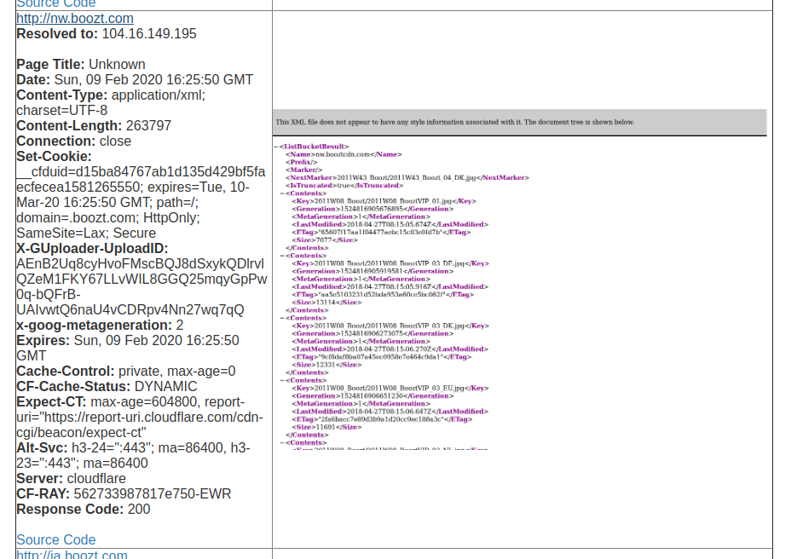
View Results
Select 'y' to immediately view results
Public bucket?

Slide 69
Results
When faced with many subdomains and hosts, EyeWitness can be used to quickly assess them all
Exploitation for web sites and applications will be covered in a future lab
Any findings that look interesting should be recorded in our notes
Which of the results look most interesting?
This is the manual analysis part
Look for
Authentication or login pages
Forms
Verbose errors
Obvious misconfigurations
Important Point: Knowing how to use a tool
IS NOT a substitute for good manual analysis

Slide 70
Scanning Results

Slide 71
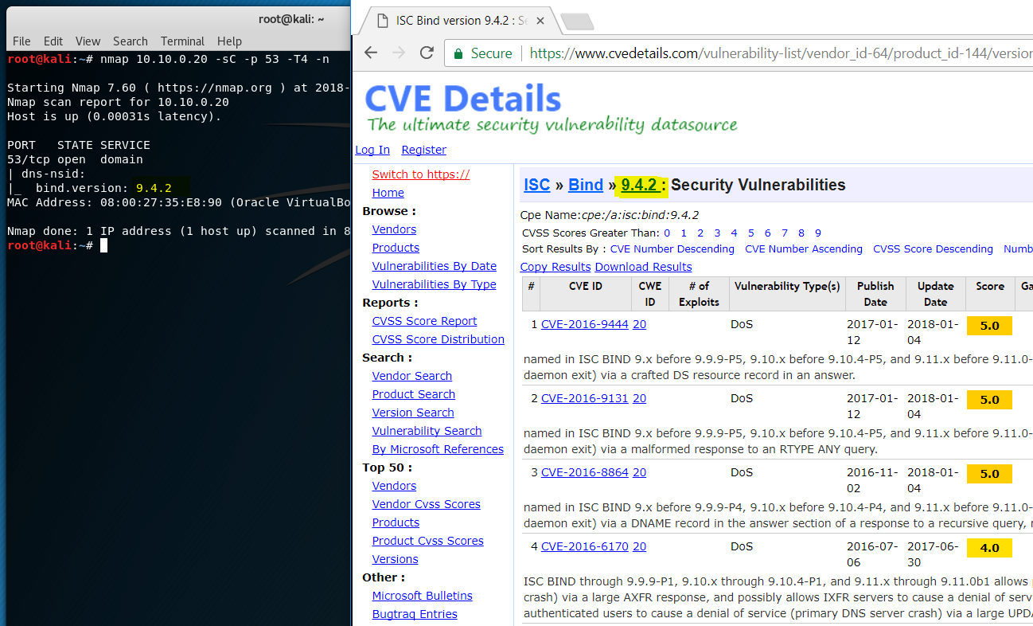
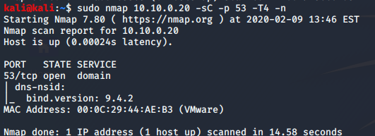
Scanning Results
Now that you have completed a scan to fully assess the attack surface of this server, we can begin to perform in-depth assessment of each exposure
Spend more time practicing with nmap, netcat, scapy
Try learning more about the versions of each service
Try script scanning and identify particular scripts to help you learn about each of the running services
Can you identify any vulnerabilities based off the information we learn?

Slide 72
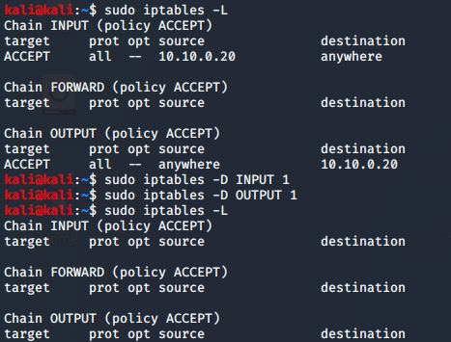
iptables cleanup
Clear out any of the rules you added
-D for delete a [chain] [number]
[chain] is INPUT, OUTPUT, or some other default or user created one
[number] for which rule number to delete, or just type out the rule
$ sudo iptables -D INPUT 1
$ sudo iptables -D OUTPUT 1

Slide 73
DONE
This is the end of the lab and we will continue to look at Metasploitable2 in the next lab

